Slide 1
CCNA Security
Chapter Two
Securing Network Devices

Slide 2
Lesson Planning
This lesson should take 3-6 hours to present
The lesson should include lecture, demonstrations, discussion and assessment
The lesson can be taught in person or using remote instruction

Slide 3
Major Concepts
Discuss the aspects of router hardening
Configure secure administrative access and router resiliency
Configure network devices for monitoring administrative access
Demonstrate network monitoring techniques
Secure IOS-based Routers using automated features

Slide 4
Lesson Objectives
Upon completion of this lesson, the successful participant will be able to:
Describe how to configure a secure network perimeter
Demonstrate the configuration of secure router administration access
Describe how to enhance the security for virtual logins
Describe the steps to configure an SSH daemon for secure remote management
Describe the purpose and configuration of administrative privilege levels
Configure the role-based CLI access feature to provide hierarchical administrative access

Slide 5
Lesson Objectives
Use the Cisco IOS resilient configuration feature to secure the Cisco IOS image and configuration files
Describe the factors to consider when securing the data that transmits over the network related to the network management and reporting of device activity
Configure syslog for network security
Configure SNMP for network security
Configure NTP to enable accurate time stamping between all devices
Describe the router services, interfaces, and management services that are vulnerable to network attacks and perform a security audit
Lock down a router using AutoSecure
Lock down a router using SDM
Notes:
5

Slide 6
The Edge Router
What is the edge router?
The last router between the internal network and an untrusted network such as the Internet
Functions as the first and last line of defense
Implements security actions based on the organization’s security policies
How can the edge router be secured?
Use various perimeter router implementations
Consider physical security, operating system security, and router hardening
Secure administrative access
Local versus remote router access

Slide 7









Perimeter Implementations
Single Router Approach
A single router connects the internal LAN to the Internet. All security policies are configured on this device.
Defense-in-depth Approach
Passes everything through to the firewall. A set of rules determines what traffic the router will allow or deny.
DMZ Approach
The DMZ is set up between two routers. Most traffic filtering left to the firewall
Router 1 (R1)
Internet
LAN 1 192.168.2.0
R1
Firewall
Internet
LAN 1 192.168.2.0
R1
Firewall
R2
Internet
LAN 1 192.168.2.0
DMZ
Notes:
7

Slide 8
Areas of Router Security
Physical Security
Place router in a secured, locked room
Install an uninterruptible power supply
Operating System Security
Use the latest stable version that meets network requirements
Keep a copy of the O/S and configuration file as a backup
Router Hardening
Secure administrative control
Disable unused ports and interfaces
Disable unnecessary services
Notes:
8

Slide 9
Banner Messages
Banners are disabled by default and must be explicitly enabled.
There are four valid tokens for use within the message section of the banner command:
$(hostname)—Displays the hostname for the router
$(domain)—Displays the domain name for the router
$(line)—Displays the vty or tty (asynchronous) line number
$(line-desc)—Displays the description that is attached to the line
R1(config)# banner {exec | incoming | login | motd | slip-ppp} d message d
Notes:
9

Slide 10
SSH version 1, 2
Configuring Router
SSH Commands
Connecting to Router
Using SDM to configure the SSH Daemon
What's the difference between versions 1 and 2 of the SSH protocol?
Notes:
10

Slide 11
Preliminary Steps for Configuring SSL
Complete the following prior to configuring routers for the SSH protocol:
Ensure that the target routers are running a Cisco IOS Release 12.1(1)T image or later to support SSH.
Ensure that each of the target routers has a unique hostname.
Ensure that each of the target routers is using the correct domain name of the network.
Ensure that the target routers are configured for local authentication, or for authentication, authorization, and accounting (AAA) services for username or password authentication, or both. This is mandatory for a router-to-router SSH connection.
Notes:
11

Slide 12
Configuring the Router for SSH
1. Configure the IP domain
name of the network
R1# conf t
R1(config)# ip domain-name span.com
R1(config)# crypto key generate rsa general-keys modulus 1024
The name for the keys will be: R1.span.com
% The key modulus size is 1024 bits
% Generating 1024 bit RSA keys, keys will be non-exportable...[OK]
R1(config)#
*Dec 13 16:19:12.079: %SSH-5-ENABLED: SSH 1.99 has been enabled
R1(config)# username Bob secret cisco
R1(config)# line vty 0 4
R1(config-line)# login local
R1(config-line)# transport input ssh
R1(config-line)# exit
2. Generate one way secret key
3. Verify or create a local database entry
4. Enable VTY inbound SSH sessions

Slide 13
Optional SSH Commands
R1# show ip ssh
SSH Enabled - version 1.99
Authentication timeout: 120 secs; Authentication retries: 3
R1#
R1# conf t
Enter configuration commands, one per line. End with CNTL/Z.
R1(config)# ip ssh version 2
R1(config)# ip ssh time-out 60
R1(config)# ip ssh authentication-retries 2
R1(config)# ^Z
R1#
R1# show ip ssh
SSH Enabled - version 2.0
Authentication timeout: 60 secs; Authentication retries: 2
R1#
Notes:
13

Slide 14
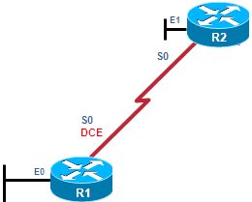
Connecting to the Router
There are two different ways to connect to an SSH-enabled router:
Connect using an SSH-enabled Cisco router
Connect using an SSH client running on a host.
1
There are no current SSH sessions ongoing with R1.
R1# sho ssh
%No SSHv2 server connections running.
%No SSHv1 server connections running.
R1#
2
R2 establishes an SSH connection with R1.
R2# ssh -l Bob 192.168.2.101
Password:
R1>
3
There is an incoming and outgoing SSHv2 session user Bob.
R1# sho ssh
Connection Version Mode Encryption Hmac State Username
0 2.0 IN aes128-cbc hmac-sha1 Session started Bob
0 2.0 OUT aes128-cbc hmac-sha1 Session started Bob
%No SSHv1 server connections running.
R1#
Notes:
14

Slide 15
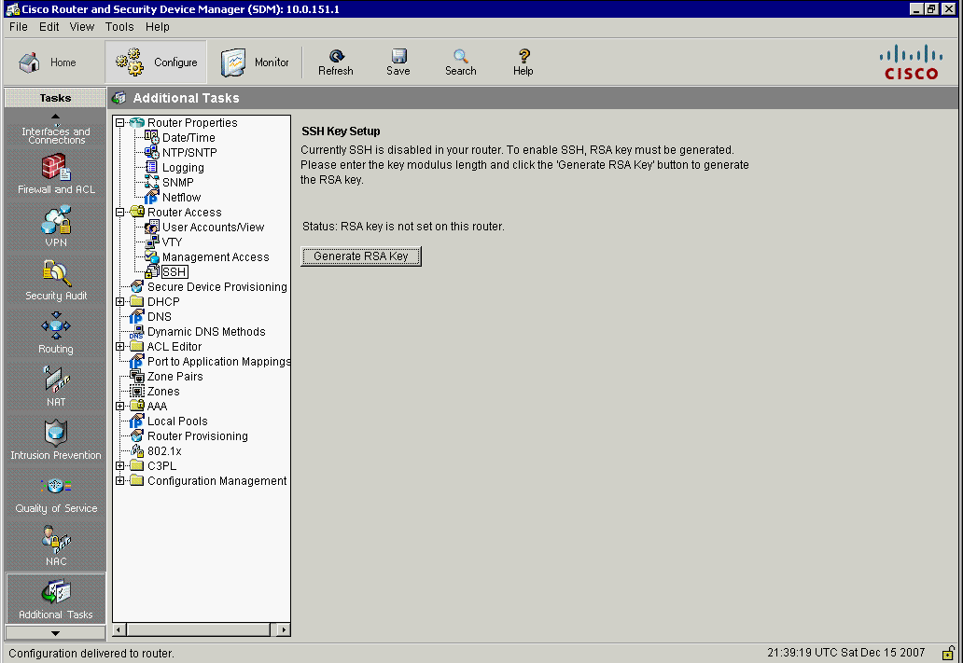
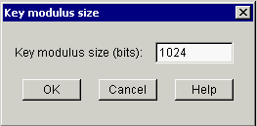
Using SDM
1. Choose Configure > Additional Tasks > Router Access > SSH
2. Possible status options:
- RSA key is not set on this router
- RSA key is set on this router
3. Enter a modulus size and
generate a key, if there is
no key configured
4. To configure SSH on the vty lines, choose Configure > Additional Tasks > Router Access > VTY
Notes:
15
The default configuration file that ships with a Cisco SDM-enabled router automatically enables Telnet and SSH access from the LAN interface and generates an RSA key.

Slide 16

Configuring for Privilege Levels
By default:
User EXEC mode (privilege level 1)
Privileged EXEC mode (privilege level 15)
Sixteen privilege levels available
Methods of providing privileged level access infrastructure access:
Privilege Levels
Role-Based CLI Access
Config AAA, Show, Firewall, IDS/IPS, NetFlow
Notes:
16

Slide 17
Privilege CLI Command
privilege mode {level level command | reset command}
router(config)#
Command | Description
mode | Specifies the configuration mode. Use the privilege ? command to see a complete list of router configuration modes available
level | (Optional) Enables setting a privilege level with a specified command
level command | (Optional) The privilege level associated with a command (specify up to 16 privilege levels, using numbers 0 to 15)
reset | (Optional) Resets the privilege level of a command
Command | (Optional) Resets the privilege level

Slide 18
Privilege Levels for Users
R1# conf t
R1(config)# username USER privilege 1 secret cisco
R1(config)#
R1(config)# privilege exec level 5 ping
R1(config)# enable secret level 5 cisco5
R1(config)# username SUPPORT privilege 5 secret cisco5
R1(config)#
R1(config)# privilege exec level 10 reload
R1(config)# enable secret level 10 cisco10
R1(config)# username JR-ADMIN privilege 10 secret cisco10
R1(config)#
R1(config)# username ADMIN privilege 15 secret cisco123
R1(config)#
A USER account with normal, Level 1 access.
A SUPPORT account with Level 1 and ping command access.
A JR-ADMIN account with the same privileges as the SUPPORT account plus access to the reload command.
An ADMIN account which has all of the regular privileged EXEC commands.

Slide 19
Privilege Levels
The enable level command is used to switch
from Level 1 to Level 5
R1> enable 5
Password:
R1# <cisco5>
R1# show privilege
Current privilege level is 5
R1#
R1# reload
Translating "reload"
Translating "reload"
% Unknown command or computer name, or unable to find computer address
R1#
The show privilege command displays
The current privilege level
The user cannot us the reload command

Slide 20
Privilege Level Limitations
There is no access control to specific interfaces, ports, logical interfaces, and slots on a router
Commands available at lower privilege levels are always executable at higher levels.
Commands specifically set on a higher privilege level are not available for lower-privileged users.
Assigning a command with multiple keywords to a specific privilege level also assigns any commands associated with the first keywords to the same privilege level.

Slide 21
Role-Based CLI
Controls which commands are available to specific roles
Different views of router configurations created for different users providing:
Security: Defines the set of CLI commands that is accessible by a particular user by controlling user access to configure specific ports, logical interfaces, and slots on a router
Availability: Prevents unintentional execution of CLI commands by unauthorized personnel
Operational Efficiency: Users only see the CLI commands applicable to the ports and CLI to which they have access

Slide 22
Role-Based Views
Root View
To configure any view for the system, the administrator must be in the root view. Root view has all of the access privileges as a user who has level 15 privileges.
CLI View
A specific set of commands can be bundled into a “CLI view”. Each view must be assigned all commands associated with that view and there is no inheritance of commands from other views. Additionally, commands may be reused within several views.
Superview
Allow a network administrator to assign users and groups of users multiple CLI views at once instead of having to assign a single CLI view per user with all commands associated to that one CLI view.

Slide 23
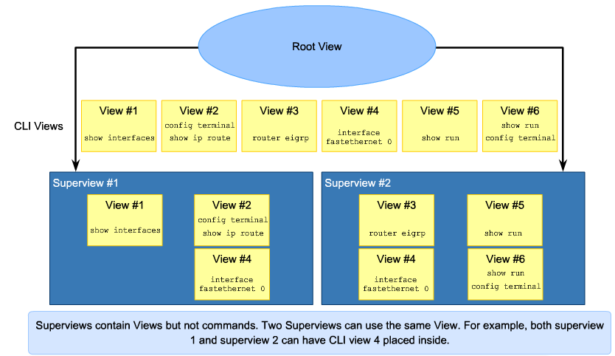
Role-Based Views

Slide 24
Creating and Managing a View
Enable aaa with the global configuration command aaa new-model. Exit, and enter the root view with the command enable view command.
Create a view using the parser view view-name command.
Assign a secret password to the view using the secret encrypted-password command.
Assign commands to the selected view using the parser-mode {include | include-exclusive | exclude} [all] [interface interface-name | command] command in view configuration mode.
Exit the view configuration mode by typing the command exit.

Slide 25
View Commands
enable [view [view-name]]
router#
Command is used to enter the CLI view.
Parameter | Description
view | Enters view, which enables users to configure CLI views. This keyword is required if you want to configure a CLI view.
view-name | (Optional) Enters or exits a specified CLI view. This keyword can be used to switch from one CLI view to another CLI view.
router(config)#
parser view view-name
Creates a view and enters view configuration mode.
router(config-view)#
secret encrypted-password
Sets a password to protect access to the View.
Password must be created immediately after creating a view
Notes:
Remember, the aaa-new model command must be configured prior to entering a view.

Slide 26
Creating and Managing a Superview
Create a view using the parser view view-name superview command and enter superview configuration mode.
Assign a secret password to the view using the secret encrypted-password command.
Assign an existing view using the view view-name command in view configuration mode.
Exit the superview configuration mode by typing the command exit.

Slide 27
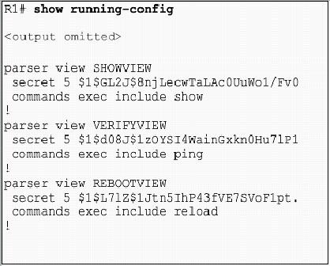
Running Config “Views”

Slide 28
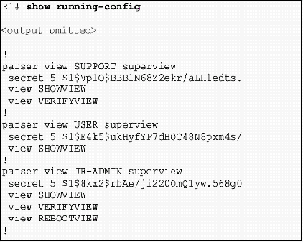
Running Config “SUPERVIEWS”

Slide 29
Verifying a View
R1# show parser view
No view is active ! Currently in Privilege Level Context
R1#
R1# enable view
Password:
*Mar 1 10:38:56.233: %PARSER-6-VIEW_SWITCH: successfully set to view 'root'.
R1#
R1# show parser view
Current view is 'root'
R1#
R1# show parser view all
Views/SuperViews Present in System:
SHOWVIEW
VERIFYVIEW

Slide 30

Resilient Configuration Facts
The configuration file in the primary bootset is a copy of the running configuration that was in the router when the feature was first enabled.
The feature secures the smallest working set of files to preserve persistent storage space. No extra space is required to secure the primary IOS image file.
The feature automatically detects image or configuration version mismatch.
Only local storage is used for securing files.
The feature can be disabled only through a console session.
R1# erase startup-config
Erasing the nvram filesystem will remove all configuration files! Continue? [confirm]

Slide 31
CLI Commands
router(config)#
secure boot-image
Enables Cisco IOS image resilience. Prevents the IOS image from being deleted by a malicious user.
router(config)#
secure boot-config
Takes a snapshot of the router running configuration and securely archives it in persistent storage.

Slide 32
Restoring Primary bootset
To restore a primary bootset from a secure archive:
Reload the router using the reload command.
From ROMMON mode, enter the dir command to list the contents of the device that contains the secure bootset file. The device name can be found in the output of the show secure bootset command.
Boot up the router using the secure bootset image using the boot command with the filename found in step 2. Once the compromised router boots, proceed to privileged EXEC mode and restore the configuration.
Enter global configuration mode using conf t.
Restore the secure configuration to the supplied filename using the secure boot-config restore filename.

Slide 33
Password Recovery Procedures
Connect to the console port.
Use the show version command to view and record the configuration register
Use the power switch to turn off the router, and then turn the router back on.
Press Break on the terminal keyboard within 60 seconds of power up to put the router into ROMmon.
At the rommon 1> prompt Type config 0x2142.
Type reset at the rommon 2> prompt. The router reboots, but ignores the saved configuration.
Type no after each setup question, or press Ctrl-C to skip the initial setup procedure.
Type enable at the Router> prompt.

Slide 34
Password Recovery Procedures, 2
Type copy startup-config running-config to copy the NVRAM into memory.
Type show running-config.
Enter global configuration and type the enable secret command to change the enable secret password.
Issue the no shutdown command on every interface to be used. Once enabled, issue a show ip interface brief command. Every interface to be used should display ‘up up’.
Type config-register configuration_register_setting. The configuration_register_setting is either the value recorded in Step 2 or 0x2102 .
Save configuration changes using the copy running-config startup-config command.

Slide 35
Preventing Password Recovery
R1(config)# no service password-recovery
WARNING:
Executing this command will disable password recovery mechanism.
Do not execute this command without another plan for password recovery.
Are you sure you want to continue? [yes/no]: yes
R1(config)
R1# sho run
Building configuration...
Current configuration : 836 bytes
!
version 12.4
service timestamps debug datetime msec
service timestamps log datetime msec
service password-encryption
no service password-recovery
System Bootstrap, Version 12.4(13r)T, RELEASE SOFTWARE (fc1)
Technical Support: http://www.cisco.com/techsupport
Copyright (c) 2006 by cisco Systems, Inc.
PLD version 0x10
GIO ASIC version 0x127
c1841 platform with 131072 Kbytes of main memory
Main memory is configured to 64 bit mode with parity disabled
PASSWORD RECOVERY FUNCTIONALITY IS DISABLED
program load complete, entry point: 0x8000f000, size: 0xcb80

Slide 36
Implementing Secure Management
Configuration Change Management
Know the state of critical network devices
Know when the last modifications occurred
Ensure the right people have access when new management methodologies are adopted
Know how to handle tools and devices no longer used
Automated logging and reporting of information from identified devices to management hosts
Available applications and protocols like SNMP

Slide 37
Secure Management and Reporting
When logging and managing information, the information flow between management hosts and the managed devices can take two paths:
Out-of-band (OOB): Information flows on a dedicated management network on which no production traffic resides.
In-band: Information flows across an enterprise production network, the Internet, or both using regular data channels.

Slide 38
Factors to Consider
OOB management appropriate for large enterprise networks
In-band management recommended in smaller networks providing a more cost-effective security deployment
Be aware of security vulnerabilities of using remote management tools with in-band management

Slide 39
Using Syslog
Implementing Router Logging
Syslog
Configuring System Logging
Enabling Syslog using SDM/CCP

Slide 40
Implementing Router Logging
Configure the router to send log messages to:
Console: Console logging is used when modifying or testing the router while it is connected to the console. Messages sent to the console are not stored by the router and, therefore, are not very valuable as security events.
Terminal lines: Configure enabled EXEC sessions to receive log messages on any terminal lines. Similar to console logging, this type of logging is not stored by the router and, therefore, is only valuable to the user on that line.

Slide 41
Implementing Router Logging
Buffered logging: Store log messages in router memory. Log messages are stored for a time, but events are cleared whenever the router is rebooted.
SNMP traps: Certain thresholds can be preconfigured. Events can be processed by the router and forwarded as SNMP traps to an external SNMP server. Requires the configuration and maintenance of an SNMP system.
Syslog: Configure routers to forward log messages to an external syslog service. This service can reside on any number of servers, including Microsoft Windows and UNIX-based systems, or the Cisco Security MARS appliance.

Slide 42


Syslog
Syslog servers: Known as log hosts, these systems accept and process log messages from syslog clients.
Syslog clients: Routers or other types of equipment that generate and forward log messages to syslog servers.
Public Web Server 10.2.2.3
Mail Server 10.2.2.4
Administrator Server 10.2.2.5
Syslog Client
e0/0 10.2.1.1
R3
e0/1 10.2.2.1
DMZ LAN 10.2.2.0/24
e0/2 10.2.3.1
Syslog Server 10.2.3.2
Protected LAN 10.2.3.0/24
User 10.2.3.3

Slide 43
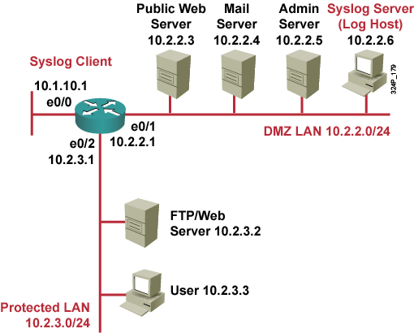
Configuring System Logging
Turn logging on and off using the logging buffered, logging monitor, and logging commands
1. Set the destination logging host
R3(config)# logging 10.2.2.6 R3(config)# logging trap informational R3(config)# logging source-interface loopback 0 R3(config)# logging on
2. Set the log severity (trap) level
4. Enable logging
3. Set the source interface
Notes:
However, if the logging on command is disabled, no messages will be sent to these destinations. Only the console will receive messages.

Slide 44
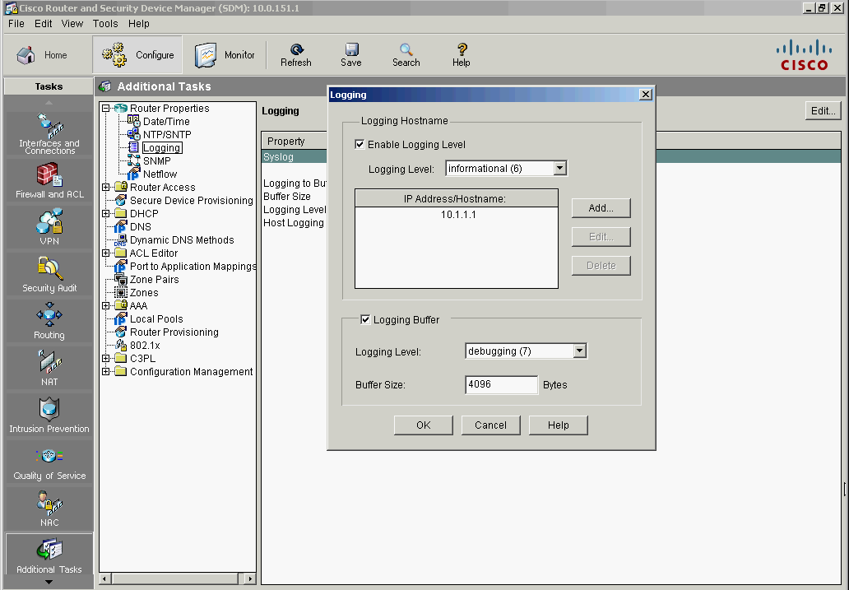
Enabling Syslog Using SDM/CCP
1. Choose Configure > Additional Tasks > Router Properties > Logging
2. Click Edit
3. Check Enable Logging Level and choose the desired logging level
4. Click Add, and enter an IP address of a logging host
5. Click OK

Slide 45
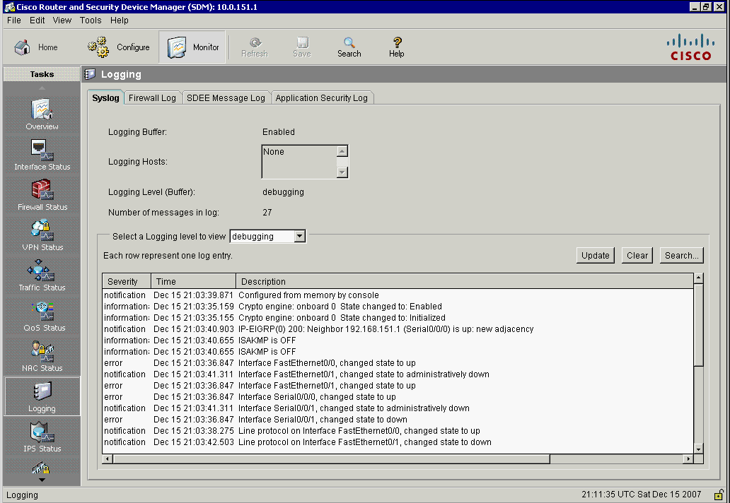
Monitor Logging with SDM
1. Choose Monitor > Logging
2. See the logging hosts to which the router logs messages
3. Choose the minimum severity level
4. Monitor the messages, update the screen to show the most current log entries, and clear all syslog messages from the router log buffer

Slide 46
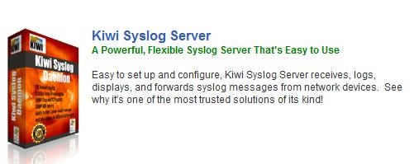
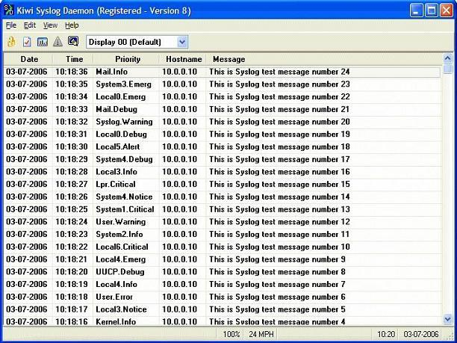
Monitor Logging Remotely
Logs can easily be viewed through the SDM, or for easier use, through a syslog viewer on any remote system.
There are numerous Free remote syslog viewers, Kiwi is relatively basic and free.
Configure the router/switch/etc to send logs to the PC’s ip address that has kiwi installed.
Kiwi automatically listens for syslog messages and displays them.

Slide 47
SNMP
Developed to manage nodes, such as servers, workstations, routers, switches, hubs, and security appliances on an IP network
All versions are Application Layer protocols that facilitate the exchange of management information between network devices
Part of the TCP/IP protocol suite
Enables network administrators to manage network performance, find and solve network problems, and plan for network growth
Three separate versions of SNMP

Slide 48
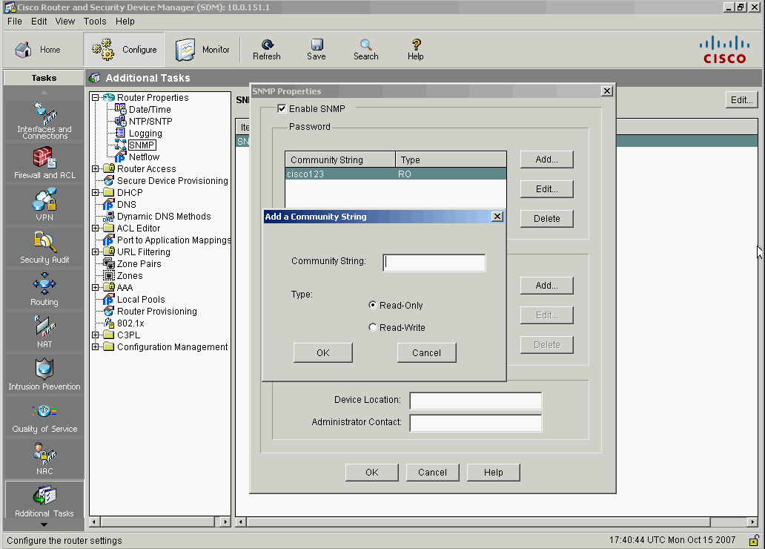
Community Strings
A text string that can authenticate messages between a management station and an SNMP agent and allow access to the information in MIBs
Provides read-only access to all objects in the MIB except the community strings.
Provides read-write access to all objects in the MIB except the community strings.

Slide 49




SNMPv3
Transmissions from manager to agent may be authenticated to guarantee the identity of the sender and the integrity and timeliness of a message.
NMS
Managed Node
Managed Node
Encrypted Tunnel
Messages may be encrypted to ensure privacy
Managed Node
Agent may enforce access control to restrict each principal to certain actions on certain portions of its data.
NMS
Managed Node

Slide 50
Security Levels
noAuth: Authenticates a packet by a string match of the username or community string
auth: Authenticates a packet by using either the Hashed Message Authentication Code (HMAC) with Message Digest 5 (MD5) method or Secure Hash Algorithms (SHA) method.
Priv: Authenticates a packet by using either the HMAC MD5 or HMAC SHA algorithms and encrypts the packet using the Data Encryption Standard (DES), Triple DES (3DES), or Advanced Encryption Standard (AES) algorithms.

Slide 51
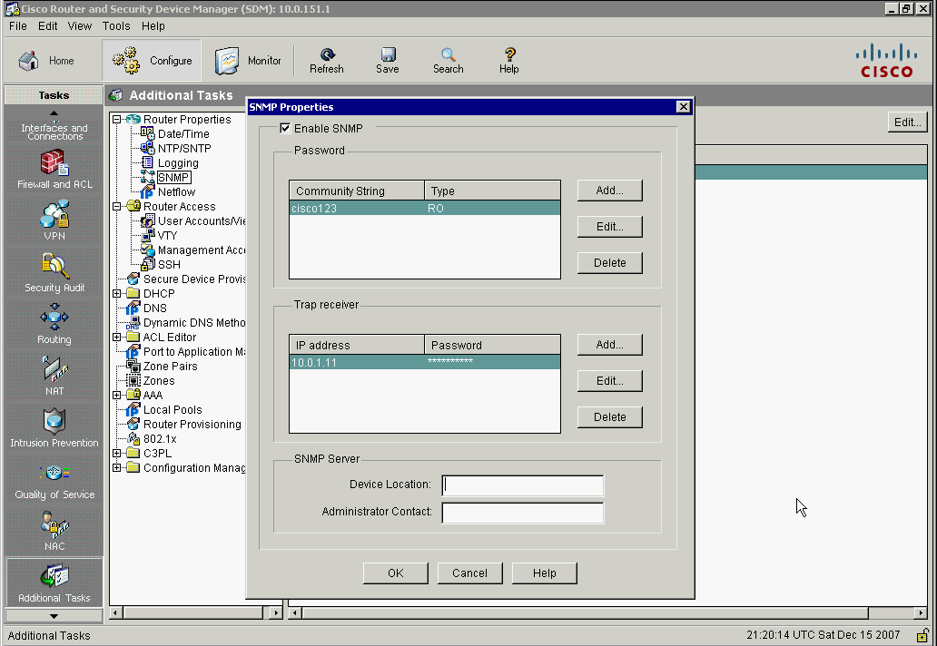
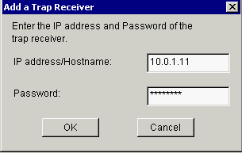
Trap Receivers
1. Click Edit
3. Enter the IP address or the hostname of the trap receiver and the password
2. Click Add
5. To edit or delete an existing trap receiver, choose a trap receiver from the trap receiver list and click Edit or Delete
6. When the trap receiver list is complete, click OK
4. Click OK

Slide 52

Using NTP
Clocks on hosts and network devices must be maintained and synchronized to ensure that log messages are synchronized with one another
The date and time settings of the router can be set using one of two methods:
Manually edit the date and time
Configure Network Time Protocol

Slide 53
Timekeeping
Pulling the clock time from the Internet means that unsecured packets are allowed through the firewall
Many NTP servers on the Internet do not require any authentication of peers
Devices are given the IP address of NTP masters. In an NTP configured network, one or more routers are designated as the master clock keeper (known as an NTP Master) using the ntp master global configuration command.
NTP clients either contact the master or listen for messages from the master to synchronize their clocks. To contact the server, use the ntp server ntp-server-address command.
In a LAN environment, NTP can be configured to use IP broadcast messages instead, by using the ntp broadcast client command.

Slide 54
Features/Functions
There are two security mechanisms available:
An ACL-based restriction scheme
An encrypted authentication mechanism such as offered by NTP version 3 or higher
Implement NTP version 3 or higher. Use the following commands on both NTP Master and the NTP client.
ntp authenticate
ntp authentication key md5 value
ntp trusted-key key-value

Slide 55
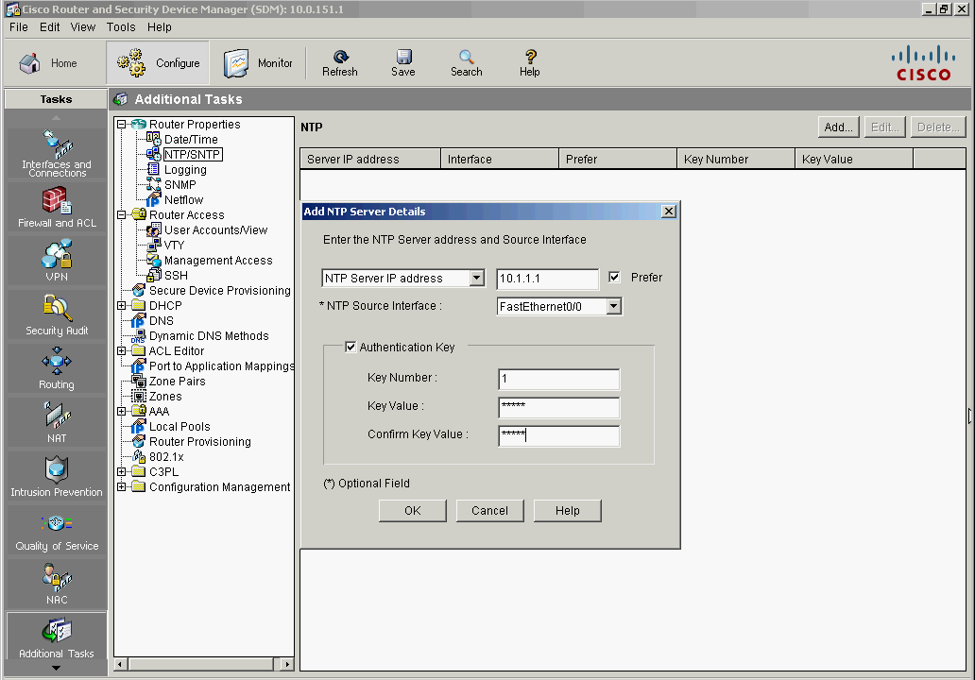
Enabling NTP
1. Choose Configure > Additional Tasks > Router Properties > NTP/SNTP
2. Click Add
3. Add an NTP server by name or by IP address
5. Check Prefer if this NTP server is a preferred server (more than one is allowed)
4. Choose the interface that the router will use to communicate with the NTP server
6. If authentication is used, check Authentication Key and enter the key number, the key value, and confirm the key value.
7. Click OK

Slide 56
Security Practices
Determine what devices should use CDP
To ensure a device is secure:
Disable unnecessary services and interfaces
Disable and restrict commonly configured management services, such as SNMP
Disable probes and scans, such as ICMP
Ensure terminal access security
Disable gratuitous and proxy Address Resolution Protocol (ARP)
Disable IP-directed broadcast
Notes:
56

Slide 57
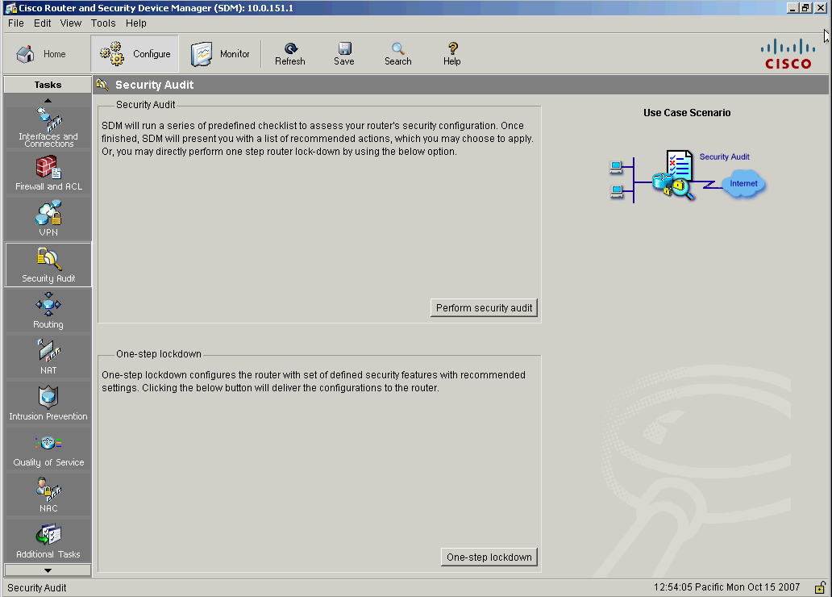
SDM Security Audit
Perform Security Audit letting the administrator choose configuration changes to implement
One-Step Lockdown automatically makes all recommended security-related configuration changes
Notes:
57

Slide 58
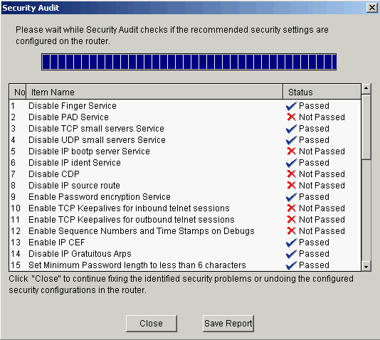
Security Audit Wizard
Compares router configuration against recommended settings:
Shut down unneeded servers
Disable unneeded services
Apply the firewall to the outside interfaces
Disable or harden SNMP
Shut down unused interfaces
Check password strength
Enforce the use of ACLs
Notes:
58

Slide 59
Cisco AutoSecure
Initiated from CLI and executes a script. The AutoSecure feature first makes recommendations for fixing security vulnerabilities, and then modifies the security configuration of the router.
Can lockdown the management plane functions and the forwarding plane services and functions of a router
Used to provide a baseline security policy on a new router
Notes:
59

Slide 60
Auto Secure Command
Command to enable the Cisco AutoSecure feature setup:
auto secure [no-interact]
In Interactive mode, the router prompts with options to enable and disable services and other security features. This is the default mode but can also be configured using the auto secure full command.
Notes:
60

Slide 61
Auto Secure Command
router#
auto secure [no-interact | full] [forwarding | management ] [ntp | login | ssh | firewall | tcp-intercept]
R1# auto secure ?
firewall AutoSecure Firewall
forwarding Secure Forwarding Plane
full Interactive full session of AutoSecure
login AutoSecure Login
management Secure Management Plane
no-interact Non-interactive session of AutoSecure
ntp AutoSecure NTP
ssh AutoSecure SSH
tcp-intercept AutoSecure TCP Intercept
<cr>
R1#
Notes:
61

Slide 62
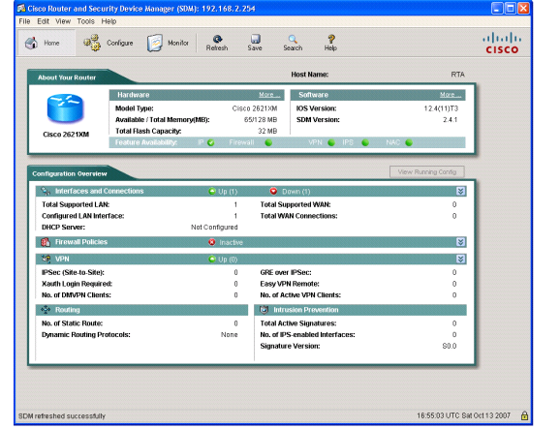
Cisco One-step Lockdown
Tests router configuration for any potential security problems and automatically makes the necessary configuration changes to correct any problems found
Notes:
62

Slide 63
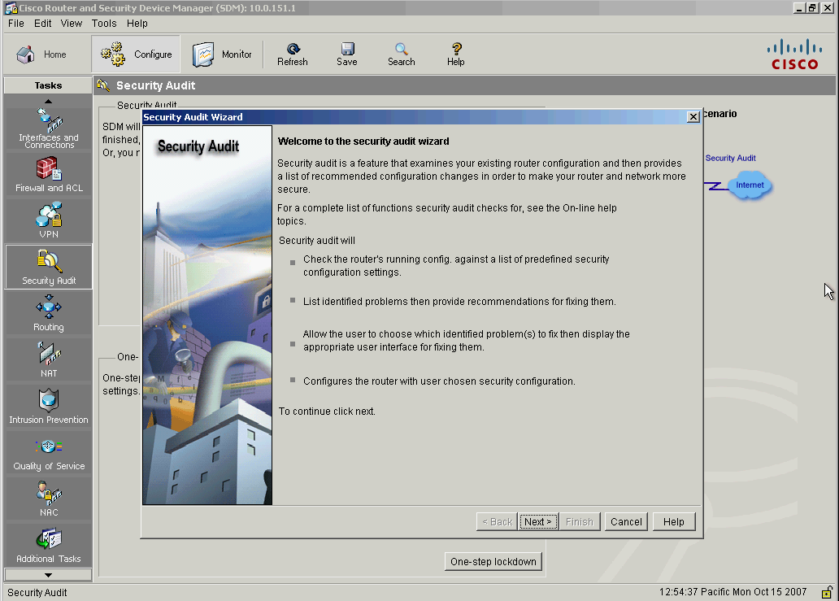
AutoSecure Versus SDM Security Audit One-Step Lockdown
R1# auto secure
--- AutoSecure Configuration ---
*** AutoSecure configuration enhances the security of the router, but it will not make it absolutely resistant to all security attacks ***
AutoSecure will modify the configuration of your device.
All configuration changes will be shown. For a detailed explanation of how the configuration changes enhance security and any possible side effects, please refer to Cisco.com for Autosecure documentation.
SDM implements some the following features differently:
SNMP is disabled but will not configure SNMPv3
SSH is enabled and configured with images that support this feature.
Secure Copy Protocol (SCP) is not enabled--unsecure FTP is.
Cisco AutoSecure also:
Disables NTP
Configures AAA
Sets SPD values
Enables TCP intercepts
Configures anti-spoofing ACLs on outside-facing interfaces
Notes:
63

Slide 64


